Slide 1
5COSC020W DATABASE SYSTEMS – LECTURE 05
Database Implementation & Querying – Simple Queries
Creating tables and retrieving records from single Tables in SQL

Slide 2
Lecture 05 – Outline
DBMS and DB Languages.
Data Definition Language (DDL); Data Manipulation Language (DML); Data Control Language (DCL).
SQL – Structured Query Language.
Capabilities, Properties & Statements.
Popular RDBMSs
Oracle and MySQL; MySQL architecture; MySQL compliance with standard SQL
SQL to create and populate tables.
Creating tables with CREATE; populating tables with INSERT INTO.
SQL to query existing tables.
Retrieving columns with SELECT FROM; arithmetic expressions; concatenating.
Restricting rows with WHERE; comparison and logical operators; precedence.
Sorting data with ORDER BY.

Slide 3
Phases and outputs of Database Design (recap)
Data Requirements
BUSINESS USER’S DATA NEEDS
to support business processes
☑
CONCEPTUAL DESIGN
CONCEPTUAL DATA MODEL OR CONCEPTUAL SCHEMA
of the data required by business users
☑
LOGICAL DESIGN (Mapping)
LOGICAL DATA MODEL OR LOGICAL SCHEMA
based on specific file data organisation (e.g. relational model)

PHYSICAL DESIGN
PHYSICAL OR INTERNAL SCHEMA
storage structures, file organizations, indexes, access paths
☑
DATABASE IMPLEMENTATION & QUERYING
DATABASE IMPLEMENTED & QUERIED IN DBMS
data structures, constraints, data values, data description

Slide 4
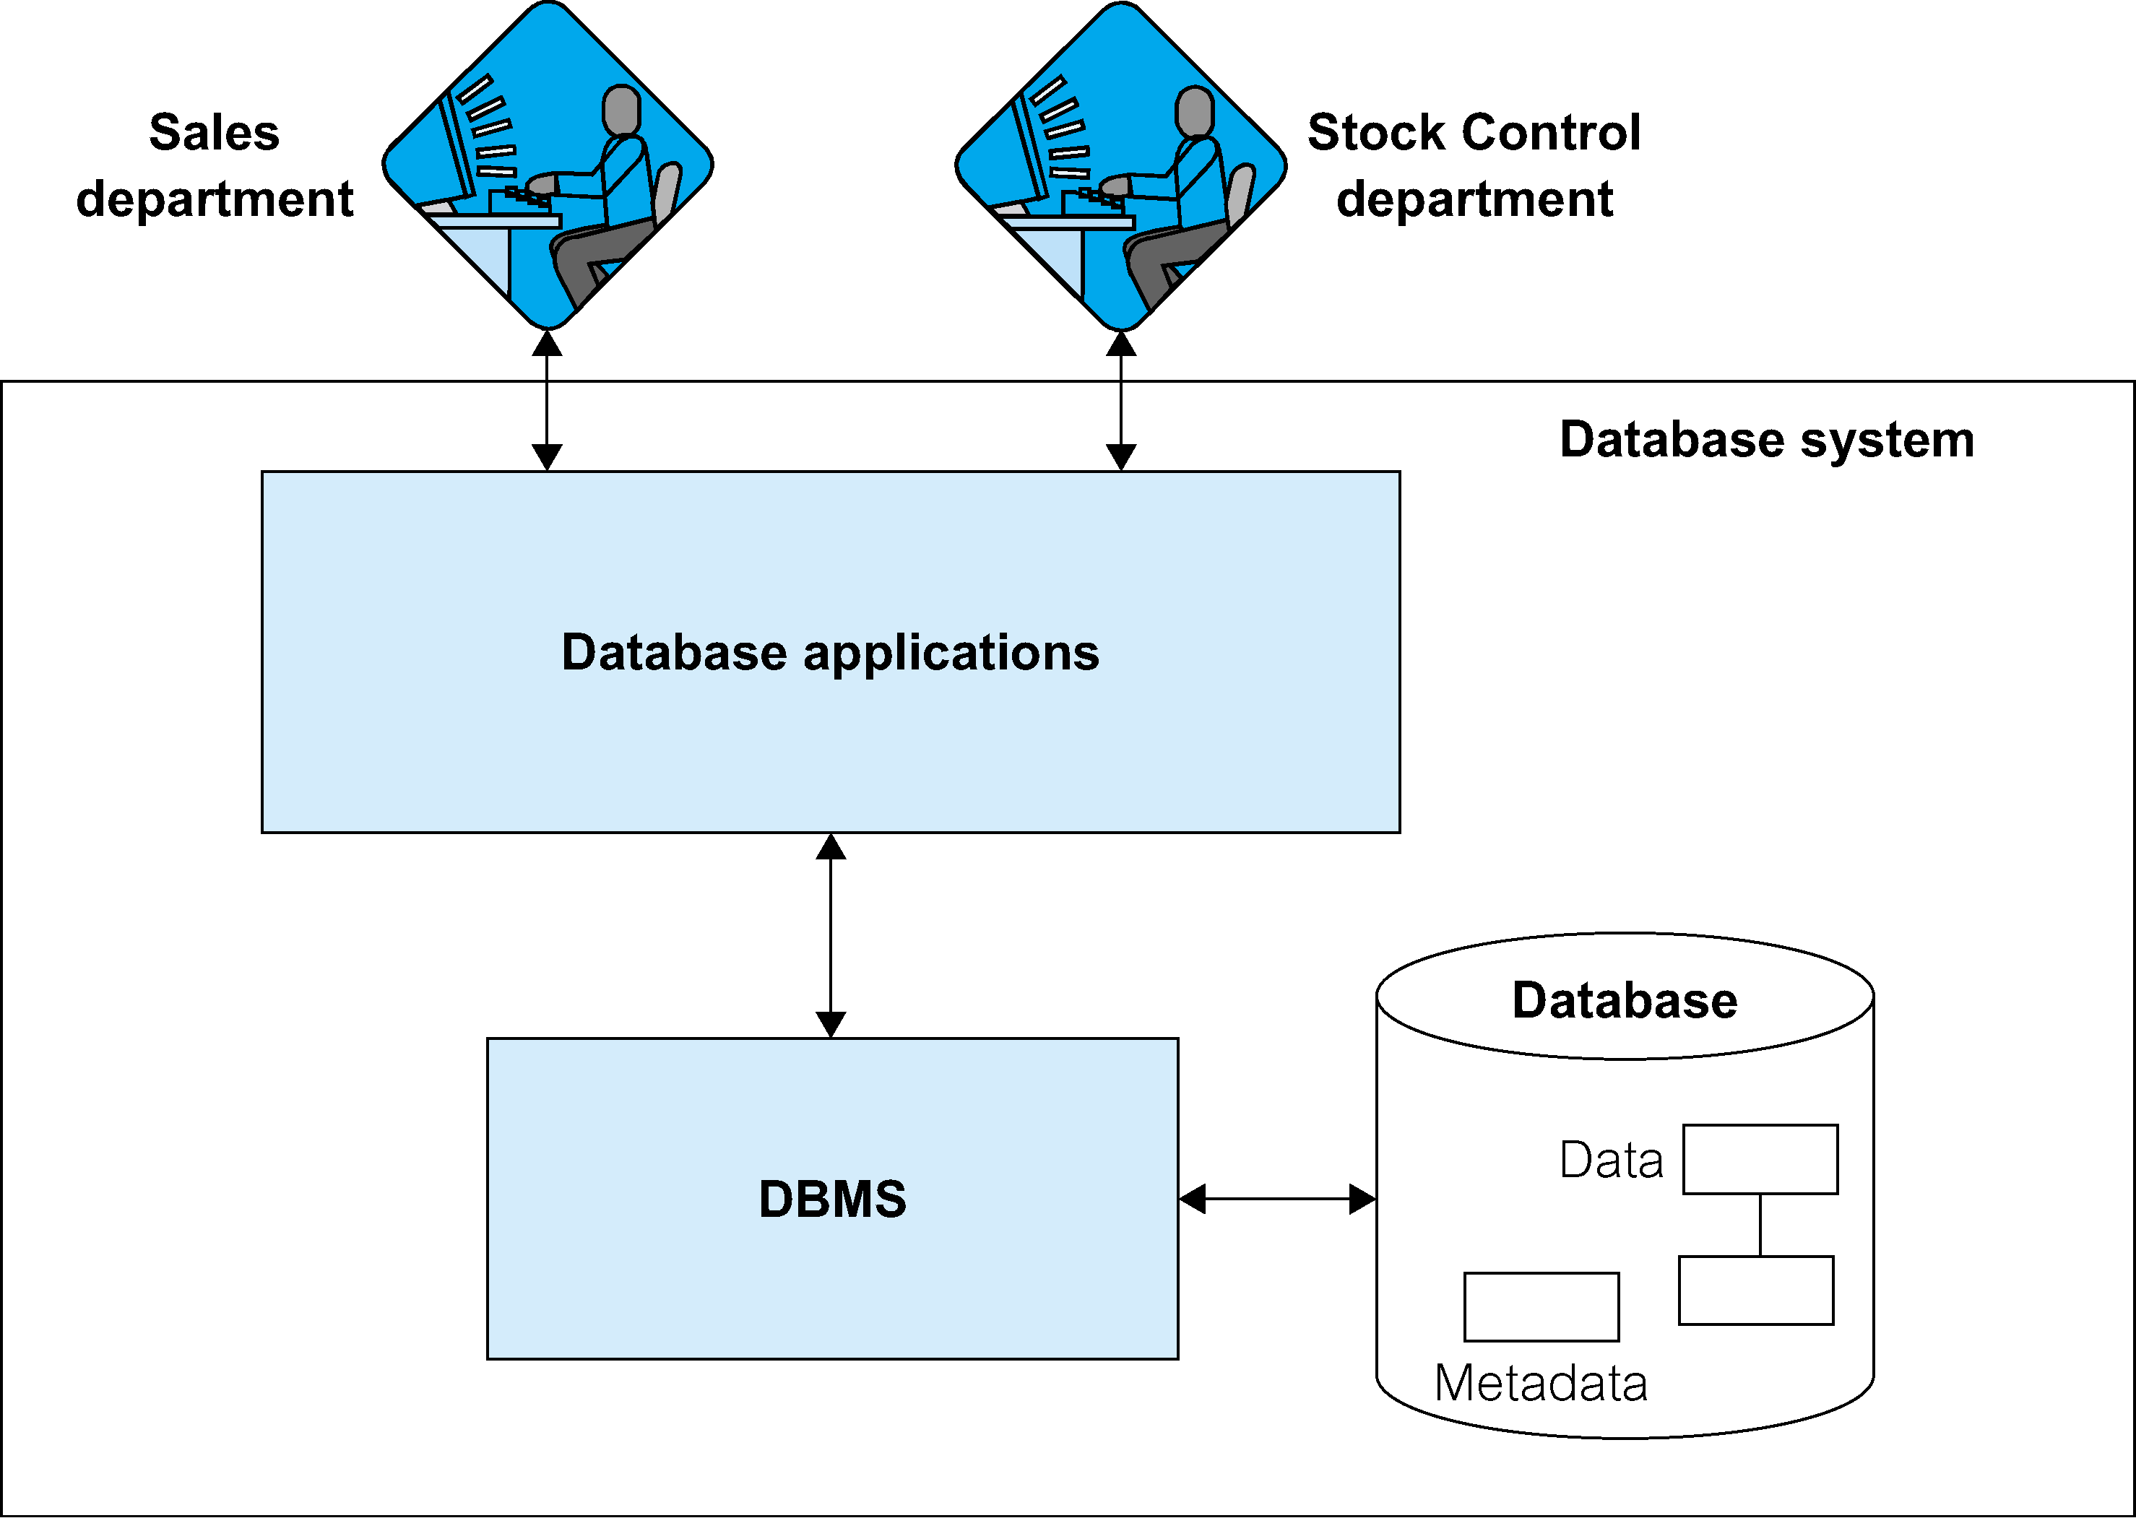
Database System
5COSC024W
Server-side
Web Development
5COSC020W
DATABASE
SYSTEMS

Slide 5
Database Management System (DBMS)
Software that allows users to:
Define a database Data Definition Language (DDL)
Specify data types, structures & constraints of the data
Specify the meta-data: description of the data
Construct a database Data Manipulation Language (DML)
Store data in storage medium controlled by DBMS
Manipulate a database Data Manipulation Language (DML)
Querying, updating and reporting on the data
Control access to a database Data Control Language (DCL)
Ensuring security, integrity, concurrency & recovery

Slide 6
SQL – Structured Query Language
Pronounced “S.Q.L” or “Sequel”.
Comprehensive database language, allows users to:
create the database and relation structures;
perform insertion, modification, deletion of data from relations;
perform simple and complex queries.
SQL enables the CRUD operations
Create new records in the database tables.
Read or Retrieve records from the database tables.
Update existing records in database tables.
Delete records from database tables

Slide 7
SQL Capabilities
Supporting data definition, queries and updates.
CRUD operations
Defining views on the database.
Customised access to a subset of the database.
Specifying security and authorisation.
Ensure only authorised users can access DB: which DB objects & which operation.
Defining integrity constraints
Entity integrity (rule on PK) and referential integrity (rule on FK).
Embedding SQL statements into other programming language
C/C++, Java, Python, PHP, etc.

Slide 8
SQL Properties
Portable and standardised
ANSI/ISO make it the formal and standard language for relational DBs.
Core: implemented by all RDBMs vendors.
Specialised extensions: spatial data, temporal data, data mining, data warehousing, OLAP.
Multi-user
DBA, Database Designer, Application Developer.
Non procedural
Specify what data is required, not how to get it
Close to natural language and easy to learn: simple English keywords
CREATE; INSERT INTO; ALTER; DELETE
SELECT FROM WHERE

Slide 9
SQL Statements and subsets of SQL
SELECT INSERT UPDATE DELETE MERGE | Data Manipulation Language (DML)
CREATE ALTER DROP RENAME TRUNCATE COMMENT | Data Definition Language (DDL)
GRANT REVOKE | Data Control Language (DCL)
COMMIT ROLLBACK SAVEPOINT | Transaction Control

Slide 10
2 essential DBMSs: Oracle and MySQL
Oracle
Commercial multi-model DBMS: primarily ORDBMS with add-ons.
Commonly used for online transaction processing (OLTP) and Data Warehousing (DW) and mixed (OLTP & DW).
Available on-prem, on-cloud or as hybrid cloud installation.
Latest release – Oracle Database 21c: native JSON data type, In-database JavaScript execution, SQL Macros to call PL/SQL, optimised graph models, in-database machine learning, blockchain tables, etc. (Oracle Database Insider, 2021)
MySQL ⚠️Not to be confused with language SQL
Open-source multi-model DBMS: primarily RDBMS with add-ons.
Bought by Sun Microsystems (2008) which was then bought by Oracle (2010).
Latest release – MySQL 8.0: transactional data dictionary, SQL roles for permissions, MySQL DB service for cloud-native apps, document store for NoSQL apps, JSON support (MySQL, 2021)

Slide 11
Classifying DBMSs based on Data Models
Relational Databases or SQL Databases (covered in lectures 01-07)
Structured Data as collection of tables with fields, records, PKs and FKs.
Uses high level Structured Query Language (SQL) for CRUD operations.
XML Databases (covered in lectures 08-10)
Semistructured data as elements that can be nested to create tree structures.
Standard for structuring and exchanging data over the Web.
NoSQL Databases (covered in lectures 11)
Key-value data model: each data value associated to unique key for fast retrieval.
Graph data model: data represented as graphs i.e. labelled nodes and edges.
Document data model: data as collection of documents in JSON or XML.
Object Databases (not covered in this module)
Data as collection of objects (in classes) with properties & operations.

Slide 12
Most popular Database Management Systems (August 2021)
 | DBMS | DB Model | Multi-Model (MM) or Single-Model (SM)
1 | Oracle | Relational | MM: relational, document store, graph, RDF store, spatial
2 | MySQL | Relational | MM: relational, document store, spatial
3 | MS SQL Server | Relational | MM: relational, document store, graph, spatial
4 | PostgreSQL | Relational | MM: relational, document store, spatial
5 | MongoDB | Document | MM: document store, spatial, search engine, time series
6 | Redis | Key-value | MM: key-value, document store, graph, spatial, search engine, time series
7 | IBM Db2 | Relational | MM: relational, document store, RDF store, spatial
8 | Elasticsearch | Search Engine | MM: search engine, document store, spatial
9 | SQLite | Relational | SM: relational only
10 | MS Access | Relational | SM: relational only
(DB-Engines,2021)

Slide 13
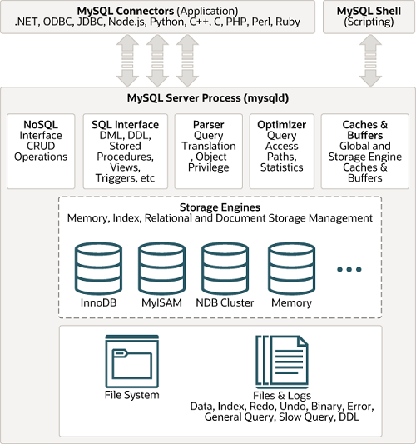
MySQL Storage engine architecture
(MySQL Developer Zone, 2021a)

Slide 14
MySQL compliance with Standard SQL
Standard SQL
Defined by the ISO/ANSI standardisation.
Multiple revisions. SQL:1999; SQL:2003; SQL:2006; SQL:2011; SQL:2016
MySQL DBMS
Claims to comply with standard SQL and to support “most of the W3C XPath standard”. (MySQL Developer Zone, 2021b)
Adds extensions to SQL or support for non-SQL features to increase the usability of MySQL Server. (MySQL Developer Zone, 2021b)
Examples of differences
General syntax: ' and " both accepted; \ is the escape character
SQL syntax: use IF EXISTS to drop a table; drop multiple tables, etc.
Operators: can be used in SELECT clause
Database objects & data types: see (MySQL Developer Zone, 2021c).

Slide 15
Database Objects
 | Standard SQL (Oracle) | SQL in MySQL
Table / Relation | Basic unit of storage; composed of rows | Basic unit of storage; composed of rows
View | Subsets of data from one or more tables | Subsets of data from one or more tables
Index | Improves performance of some queries | Improves performance of some queries
Sequence | Separate object; generates numeric values | Not a separate object; use AUTO_INCREMENT
Synonym | Separate object; gives alternative names to objects | Not a separate object

Slide 16
Simple Logical ERD
has
Dept
Emp
deptNo{PK}
dName
dLoc
createDate
0..1
0..*
empId {PK}
fName
lName
position
hireDate
salary
commPct
email
deptNo{FK}
Optional on Dept side
Optional on Emp side
Cardinalities are 1 and *
One-to-Many Relationship, Dept is the Parent table, Emp is the Child table.
Child Emp carries a FK deptNo that references deptNo the PK of its parent Dept
Participations are both 0
A record in Dept may not have any corresponding records in Emp.
A record in Emp may not have any corresponding records in dept: FK can be null.

Slide 17
Creating Dept table
CREATE TABLE Dept
(
deptNo INTEGER,
dName VARCHAR(20) UNIQUE NOT NULL,
dLoc VARCHAR(30) NOT NULL,
createDate DATE,
CONSTRAINT d_dno_pk PRIMARY KEY (deptNo)
);

Slide 18
Creating Emp table
CREATE TABLE Emp
(
empId INTEGER,
fName VARCHAR(50) NOT NULL,
lName VARCHAR(50) NOT NULL,
position VARCHAR(50) NOT NULL,
hireDate DATE NOT NULL,
salary DECIMAL(7,2) NOT NULL,
commPct DECIMAL(2,2),
email VARCHAR(100) UNIQUE NOT NULL,
deptNo INTEGER,
CONSTRAINT e_eid_pk PRIMARY KEY (empId),
CONSTRAINT e_dno_fk FOREIGN KEY (deptNo) REFERENCES Dept(deptNo)
);

Slide 19
Populating Dept tables
INSERT INTO
Dept (deptNo, dName, dLoc, createDate)
VALUES
(10, 'Database Management', 'New Cav', '2021-03-21'),
(20, 'Systems Design', 'Harrow', '2021-01-06'),
(30, 'IT Development', 'New Cav', '2021-04-25'),
(40, 'Project Management', 'Regents', '2021-02-12'),
(50, 'Systems Testing', 'Marylebone', NULL);

Slide 20
Populating Emp tables
INSERT INTO
Emp (empId, fName, lName, position, hireDate, salary, commPct, email, deptNo)
VALUES
(101, 'Joe', 'Bloggs', 'Project Manager', '2021-03-01', 5200.00, 0.25, 'jb@it.com', 40),
(102, 'Jim', 'Marts', 'Database Admin', '2021-03-22', 4400.00, NULL, 'jm@it.com', 10),
(103, 'Jen', 'Fonts', 'Python Developer', '2021-04-28', 4800.00, 0.12, 'jf@it.com', 30),
(104, 'Jon', 'Pop', 'Database Architect', '2021-03-23', 4000.00, NULL, 'jp@it.com', 10),
(105, 'Tom', 'Dogs', 'UI Designer', '2021-01-10', 4000.00, NULL, 'td@it.com', 20),
(106, 'Tek', 'Roggs', 'Project Manager', '2021-01-01', 5200.00, 0.13, 'tr@it.com', 40),
(107, 'Tim', 'Clogs', 'Java Developer', '2021-04-29', 4300.00, 0.15, 'tc@it.com', NULL),
(108, 'Tam', 'Kelps', 'UX Designer', '2021-01-15', 3900.00, NULL, 'tk@it.com', NULL);

Slide 21
Retrieving columns with SELECT…FROM clauses
Selecting all columns
SELECT *
FROM Dept;
Selecting specific columns
SELECT dName, dLoc
FROM Dept;

Slide 22
Arithmetic Expressions
Use arithmetic operators with number data and date data.
Operator | Description
+ | Add
- | Substract
* | Mulltiply
/ | Divide
Example:
SELECT lName, salary, salary + 300
FROM Emp;

Slide 23
Operator Precedence
Without brackets: * takes precedence over +.
SELECT lName, salary, 12 * salary + 200
FROM Emp;
With brackets: override * precedence and make + take precedence
SELECT lName, salary, 12 * (salary + 200)
FROM Emp;
Which one is better from an employee’s perspective?

Slide 24
Null Values
A null value is an unavailable, unassigned, unknown or inapplicable value.
A null value is not the same as zero or a blank value.
SELECT lName, salary, commPct
FROM Emp;
An arithmetic expression containing a null value will return a null value.
SELECT lName, salary, 12 * salary * commPct
FROM Emp;

Slide 25
Column Aliases
A column alias renames a column heading.
It follows the AS keyword and uses " " to display the exact same label.
SELECT lName AS "Surname", salary AS "Monthly Salary", commPct AS "Commission"
FROM Emp;
It is useful as part of calculations.
SELECT lName AS "Surname", 12 * salary AS "Yearly Salary", 12 * (salary + salary * commPct) AS "Final Intake"
FROM Emp;

Slide 26
Concatenation
Concatenate columns: use CONCAT function.
SELECT CONCAT (fName,lName) AS "Full Name"
FROM Emp;
Concatenate and introduce a blank space.
SELECT CONCAT (fName,' ',lName) AS "Full Name"
FROM Emp;
Concatenate and introduce a sting.
SELECT CONCAT (fName,' ',lName, ' is a ',position)
AS "Full Name and Job"
FROM Emp;

Slide 27
Duplicate Rows
Default display: all rows, including duplicates.
SELECT deptNo
FROM Emp;
To remove duplicates use DISTINCT.
SELECT DISTINCT deptNo
FROM Emp;
Why are many values of deptNo duplicated in the Emp table?

Slide 28
Restricting rows with the WHERE clause
No quotes required in WHERE clause with numbers.
SELECT empId, lName, position, hireDate, deptNo
FROM Emp
WHERE deptNo = 10;
Quotes required in WHERE clause with strings.
SELECT empId, lName, position, hireDate, deptNo
FROM Emp
WHERE position = 'Database Architect';
Quotes required in WHERE clause with dates.
SELECT empId, lName, position, hireDate, deptNo
FROM Emp
WHERE hireDate >= '2021-03-01';

Slide 29
Comparison Operators
Operator | Description
= | Equal to
> | Strictly greater than
>= | Greater than or equal to
< | Strictly less than
<= | Less than or equal to
<> | Not equal to
BETWEEN … AND … | Between 2 values (inclusive)
IN (SET) | Match any of the list of values
LIKE | Match a character pattern
IS NULL | Is a null value

Slide 30
Logical Operators
Operator | Description
AND | Returns TRUE if BOTH conditions are true
OR | Returns TRUE if EITHER conditions are true
NOT | Returns TRUE if condition is FALSE

Slide 31
Comparing with one or two values with BETWEEN…AND
Comparison operator in WHERE clause.
SELECT empId, lName, position, salary, deptNo
FROM Emp
WHERE salary >= 4500;
BETWEEN … AND operator (by default boundaries values are included!).
SELECT empId, lName, position, salary, deptNo
FROM Emp
WHERE salary BETWEEN 4000 AND 4800;
Two comparison operators with the AND logical operator.
SELECT empId, lName, position, salary, deptNo
FROM Emp
WHERE salary > 4000 AND salary < 4800;

Slide 32
Comparing with a list of values with IN
Using IN operator to see if a value match any of the values in a list.
SELECT empId, lName, position, hireDate, deptNo
FROM Emp
WHERE deptNo IN (10, 30, 40);
Three = comparison operators with OR logical operator to do the same.
SELECT empId, lName, position, hireDate, deptNo
FROM Emp
WHERE deptNo = 10 OR deptNo = 30 OR deptNo = 40;
Combining NOT and IN operator to get the opposite.
SELECT empId, lName, position, hireDate, deptNo
FROM Emp
WHERE deptNo NOT IN (10, 30, 40);

Slide 33
Matching Character Patterns with LIKE
Finding words that start with a specific letter.
SELECT empId, lName, position, hireDate, deptNo
FROM Emp
WHERE lName LIKE 'M%';
Finding words that contain a specific letter anywhere.
SELECT empId, lName, position, hireDate, deptNo
FROM Emp
WHERE lName LIKE '%o%';
Finding words that contain a specific letter in a specific position.
SELECT empId, lName, position, hireDate, deptNo
FROM Emp
WHERE lName LIKE '_o%';

Slide 34
Finding null values with IS NULL
Retrieving records for which one attribute has no values.
SELECT deptNo, dName, dLoc, createDate
FROM Dept
WHERE createDate IS NULL;
Retrieving records for which one attribute has values.
SELECT empId, lName, position, commPct, deptNo
FROM Emp
WHERE commPct IS NOT NULL;
Retrieving children records with no values in their FKs.
SELECT empId, lName, position, salary, deptNo
FROM Emp
WHERE deptNo IS NULL;

Slide 35
Using logical operators
AND operator
SELECT empId, lName, position, salary, deptNo
FROM Emp
WHERE position LIKE '%Database%' AND salary > 4300;
OR operator
SELECT empId, lName, position, salary, deptNo
FROM Emp
WHERE position LIKE '%Database%' OR salary > 4300;
AND with NOT
SELECT empId, lName, position, salary, deptNo
FROM Emp
WHERE deptNo NOT IN (10,30) AND salary > 4300;

Slide 36
Rules of Precedence
Precedence | Description
1 | Arithmetic Operators
2 | Concatenation
3 | Comparison conditions
4 | IS NULL, LIKE, IN
5 | BETWEEN
6 | Not equal to
7 | NOT Logical conditions
8 | AND Logical conditions
9 | OR Logical conditions
Use brackets to override rules of precedence!

Slide 37
Precedence
Without brackets: AND takes precedence over OR.
SELECT empId, lName, position, salary, deptNo
FROM Emp
WHERE position LIKE '%Database%'
OR position LIKE '%Developer%'
AND salary > 4400;
With brackets: override AND precedence and make OR take precedence.
SELECT empId, lName, position, salary, deptNo
FROM Emp
WHERE (position LIKE '%Database%'
OR position LIKE '%Developer%')
AND salary > 4400;

Slide 38
Sort DATA with ORDER BY
Sorting in ascending order: the use ASC keyword is optional.
SELECT empId, lName, hireDate, salary
FROM Emp
ORDER BY hireDate;
Sorting in descending order and using an alias.
SELECT empId, lName, hireDate, salary * 12 AS AnnSal
FROM Emp
ORDER BY AnnSal DESC;
Sorting by multiple columns
SELECT empId, lName, hireDate, salary, deptNo
FROM Emp
ORDER BY deptNo, salary DESC;

Slide 39
References
Module Reading List: https://rl.talis.com/3/westminster/lists/2CAA7D6B-DCAD-AB71-C97B-7FEFCB499C28.html
Connolly, T. & Begg, C. E. (2015). Database systems: a practical approach to design, implementation and management. 6th Edition (Global Edition). Pearson Education.
DB-Engines (2022). DB-Engines. Available from https://db-engines.com/. [Accessed 15 September 2022].
Elmasri, R. & Navathe, S. (2017). Fundamentals of Database Systems. 7th Edition (Global Edition). Pearson Education.
MySQL(2022). MySQL Enterprise Edition. https://www.mysql.com/products/enterprise/. [Accessed 15 September 2022].
MySQL Developer Zone (2022a). Overview of MySQL Storage Engine Architecture. https://dev.mysql.com/doc/refman/8.0/en/pluggable-storage-overview.html. [Accessed 15 September 2022].
MySQL Developer Zone (2022b). MySQL Standards Compliance. https://dev.mysql.com/doc/refman/8.0/en/compatibility.html. [Accessed 15 Sept 2022].
MySQL Developer Zone (2022c). MySQL Data Types. https://dev.mysql.com/doc/refman/8.0/en/data-types.html [Accessed 15 Sept 2022].

